Slide 1
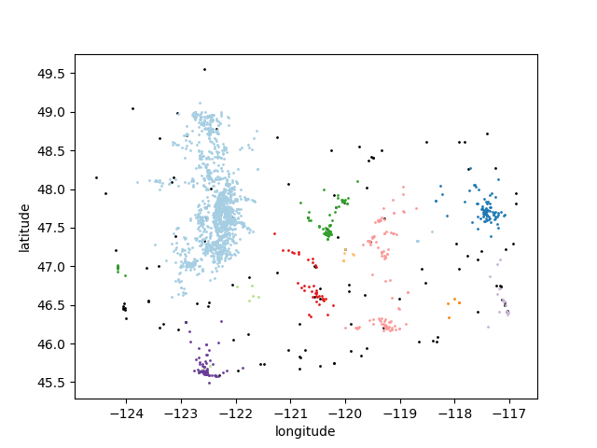
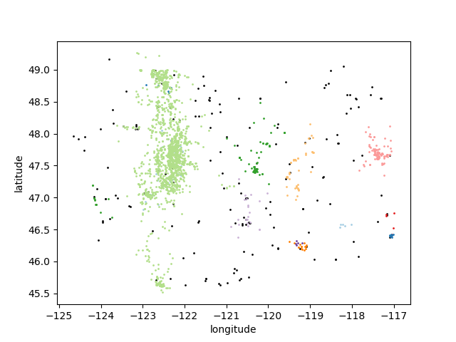
(a)Negative reports distrbution
(b)Unverified reports distrbution

Slide 2
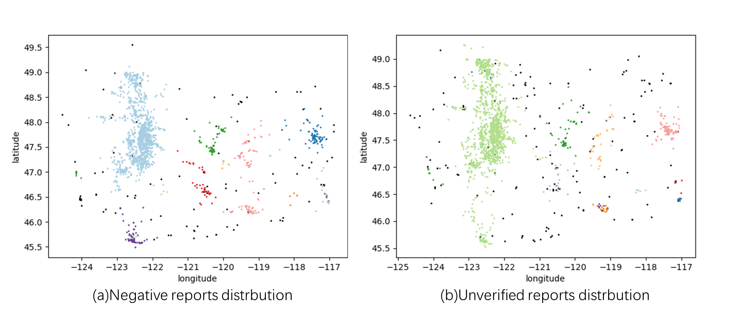

Slide 3
Positive ID
Positive ID
Positive ID
Positive ID
Positive ID
Positive ID
Positive ID
Positive ID
Unverified
Positive ID
Positive ID
Positive ID
Positive ID
Positive ID
Unverified
Unverified
Unverified
Unverified
Unverified
Unverified
Unverified

